Slide 1
Asynchronous FIFO

Slide 2
Design specification
I/O defined
From 1 to 127 buffer size. Configurable with BUFFER_SIZE parameter
Area effective
Power effective
Fast

Slide 3
Alternative approaches
Binary pointers with REQ/ACK handshaking signals
Safe
Simple
Supports any fifo depth, and arbitrary pointer changes.
Easy full/empty generation
Gray code pointers passed directly
Proven designs exists
Requires power-of-2 fifo depth(most dual-port ram is power-of-2 words deep)
Tricky full/empty generation

Slide 5
My assumptions

Slide 6
Z

Slide 7
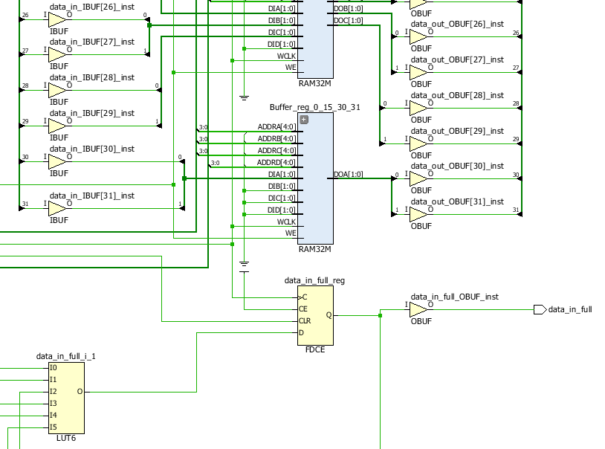
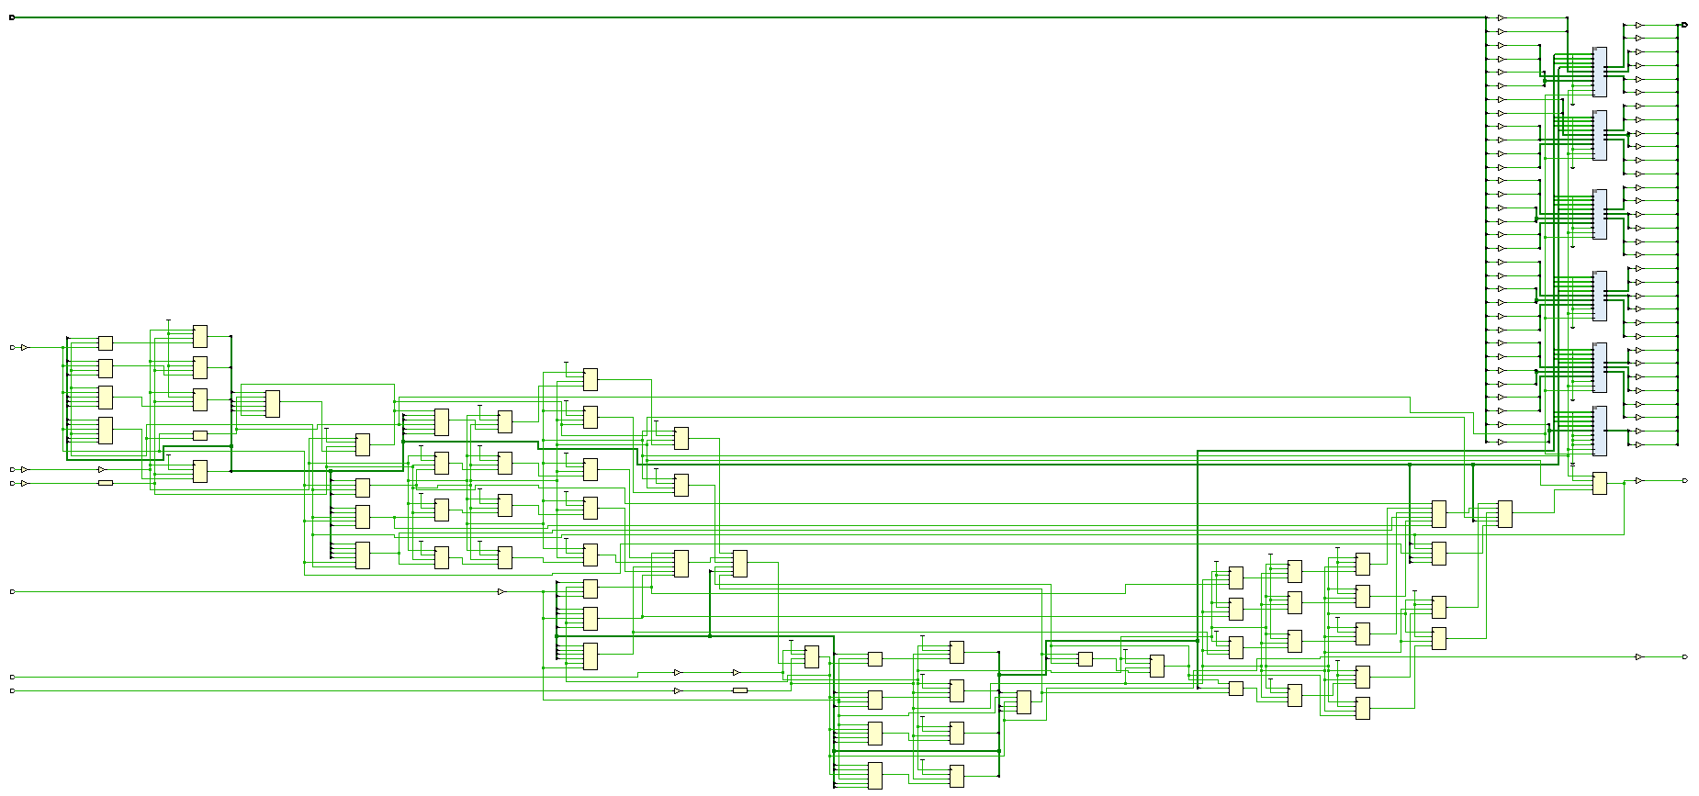
16 (RAM32M)

Slide 8
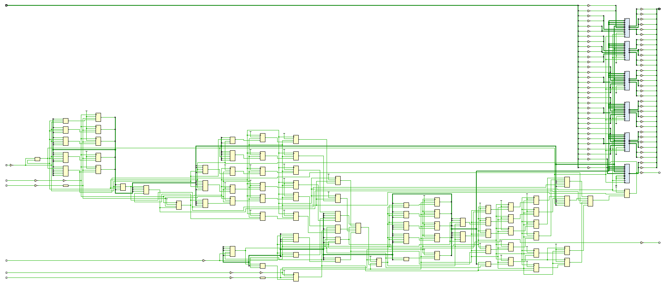
32

Slide 9
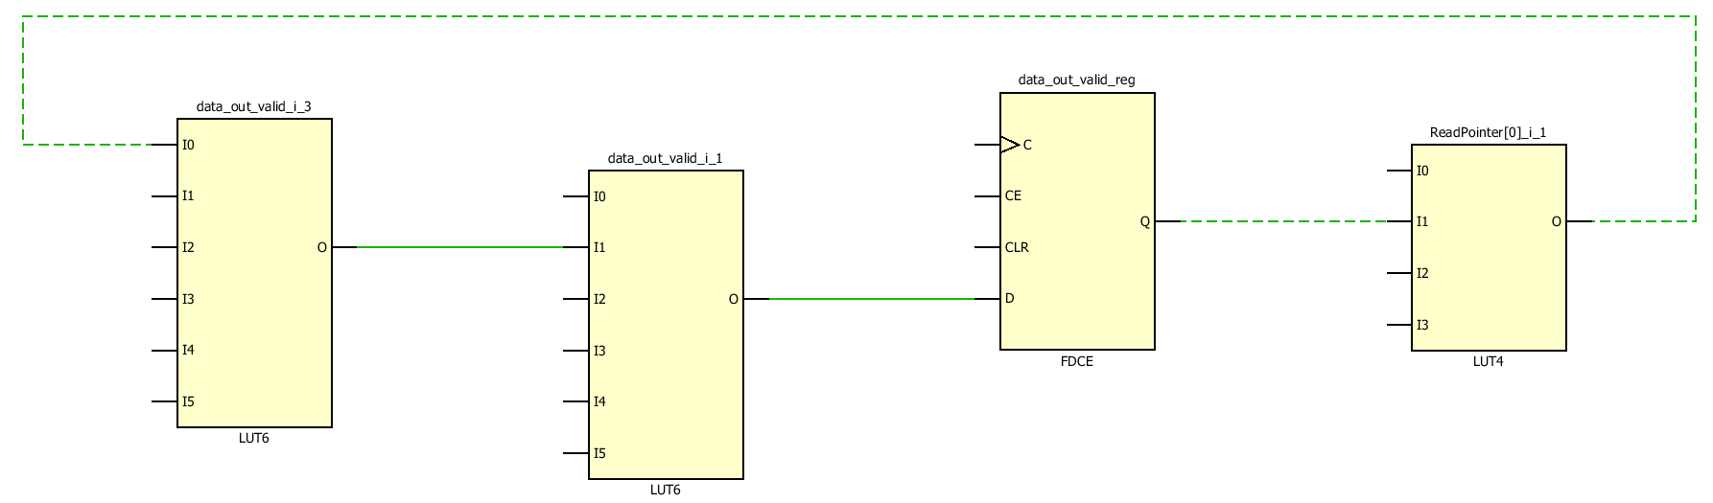
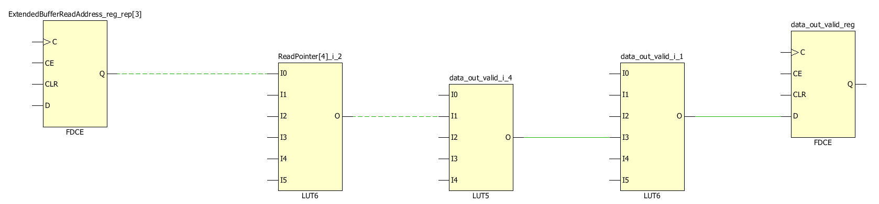
16 top vs 32 bot

Slide 10
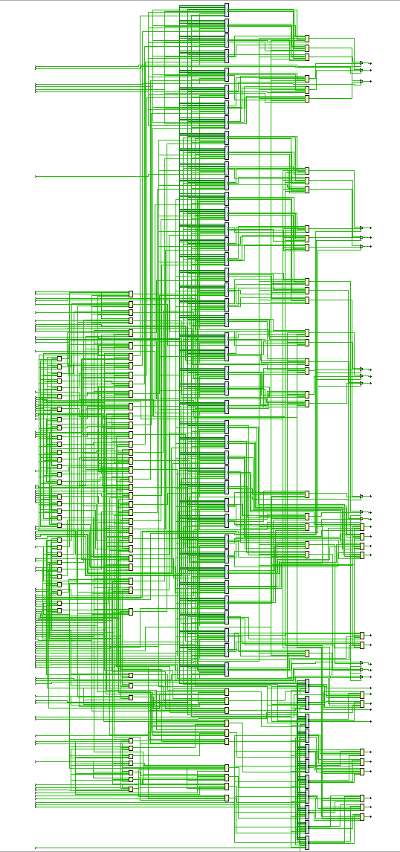
65536

Slide 11
Critical path BUFFER_SIZE 8

Slide 12
Critical path BUFFER_SIZE 128

Slide 13
RTL Analysis

Slide 14
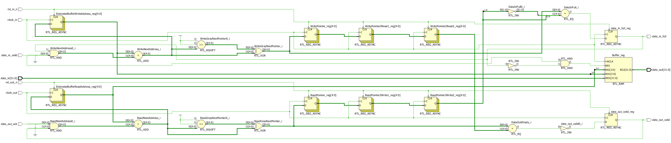

Slide 15
GRAY MSBs show octant/quartant

